Slide 1
Fall School-Based Family Data Night
November 16, 2022
Springdale Elementary
Carmen Gregory, Principal
Regina Scott, PLC Coach

Slide 2
MSCS VISION FOR STUDENT SUCCESS
We envision Memphis-Shelby County Schools (MSCS) becoming a transformational district that provides opportunities for innovation to meet the needs of all scholars.

Slide 4
Agenda
School Communication Updates (ex. Tutoring, Class Dojo, Weekly/Daily Communications, Emails, Upcoming virtual Parent Meetings)
Upcoming FACE Parent Support Opportunities
Community Based Parent Support Opportunities
MSCS Tutoring Opportunities
Registration/Enrollment, Withdrawals, & Transfers
Questions & Answers
Student Data Discussions
Purpose of School-Based Family Data Night
Accessing the SCS Parent Portal (Report Cards/ Progress Reports)
PowerSchool Academic Score Card
Assessment Department Resources for Families
Mastery Connect Updates K-5
Elementary/Middle – iReady Diagnostic/Parent Reports (Grade K-8)
MSCS Literacy Commitment (K-3)

Slide 5
Purpose
Inform parents on student progress with various assessments
Provide guidance on how to read data reports
Provide recommendations on how to assist students
Notes:
Why are we here? The purpose of this family data night is to inform parents on student progress with various assessments, provide guidance on how to read data reports, and provide recommendations on how to assist students.

Slide 6
Accessing and Viewing the Report Card

Slide 7
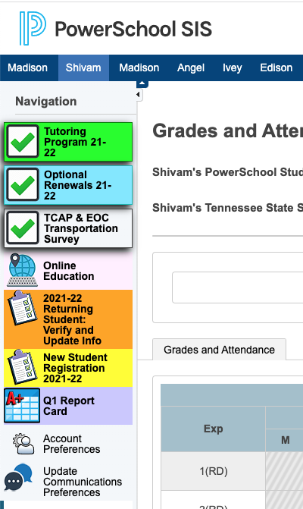
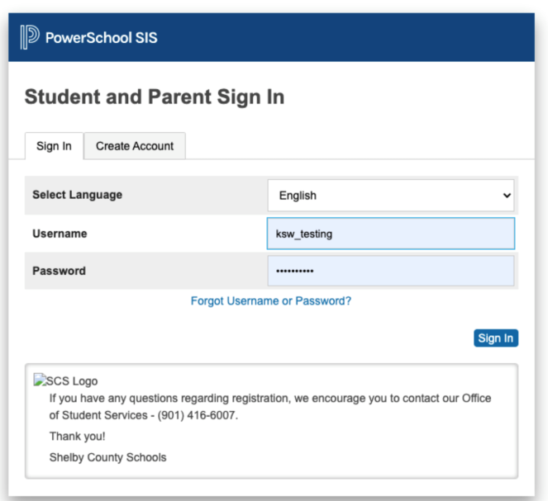
Accessing and Viewing the Report Card
Report cards will be available for the complete quarter once all school grades are stored and will be housed in the parent portal.
Access the report card, using the following link: https://scstn.powerschool.com/public/home.html
Sign into your parent account.
If you have forgotten the username or password, click on the “Forgot Username or Password” link.
After logging in, click the report card icon.

Slide 8
Accessing and Viewing the Report Card

Slide 9
PowerSchool Academic Scorecard

Slide 10
What is the Academic Scorecard?
The Academic Scorecard is a report available in PowerSchool that allows parents and guardians the ability to view their child’s academic, attendance, and behavior data in one centralized location. It can be found by logging into PowerSchool using your normal username and password.

Slide 11
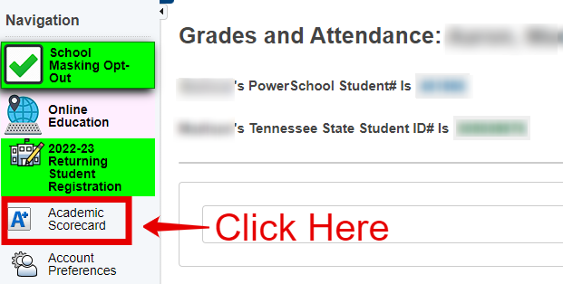
Where is it?
Once you log in to PowerSchool, on the menu to the left of the screen, you should see the ‘Academic Scorecard’ button.

Slide 12
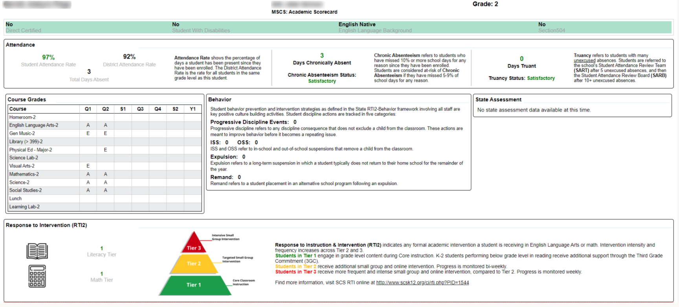
Example Scorecard

Slide 13
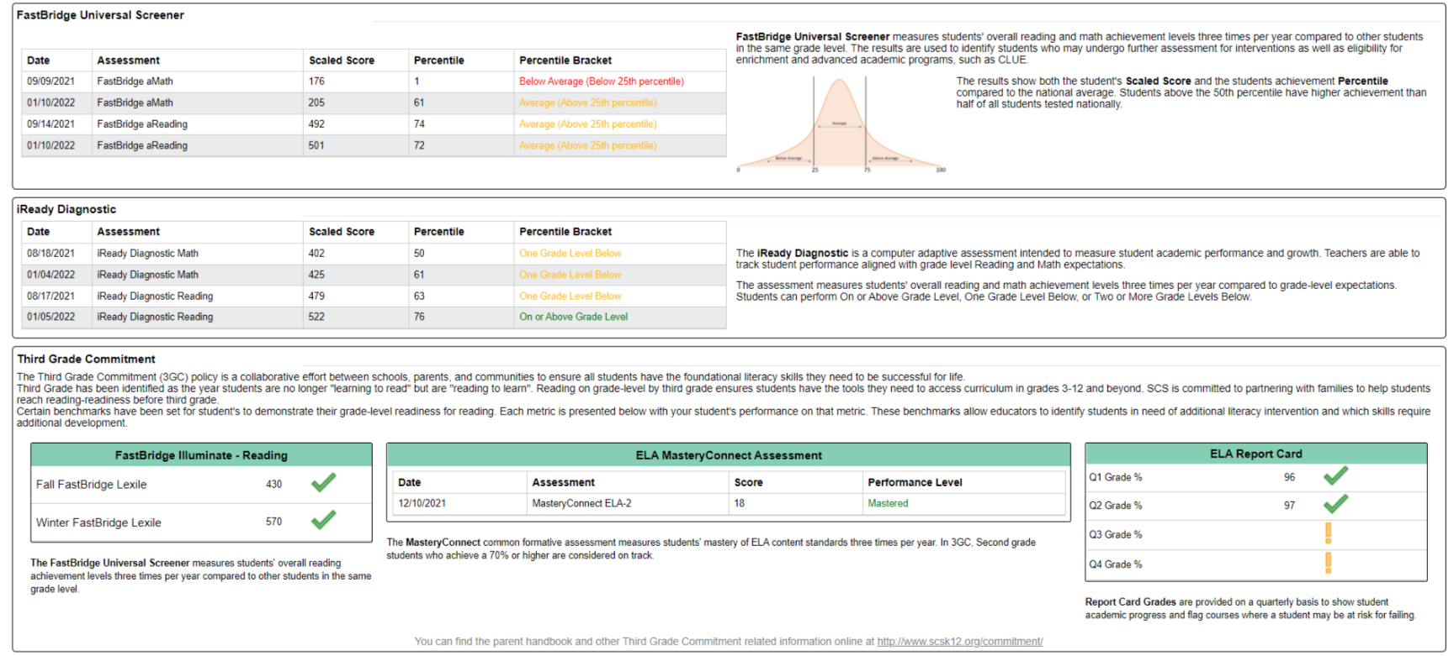
Example Scorecard

Slide 14
How to Print?
Above the report, you should see more detailed printing instructions in red and a blue ‘Print’ button right above the report itself.

Slide 15
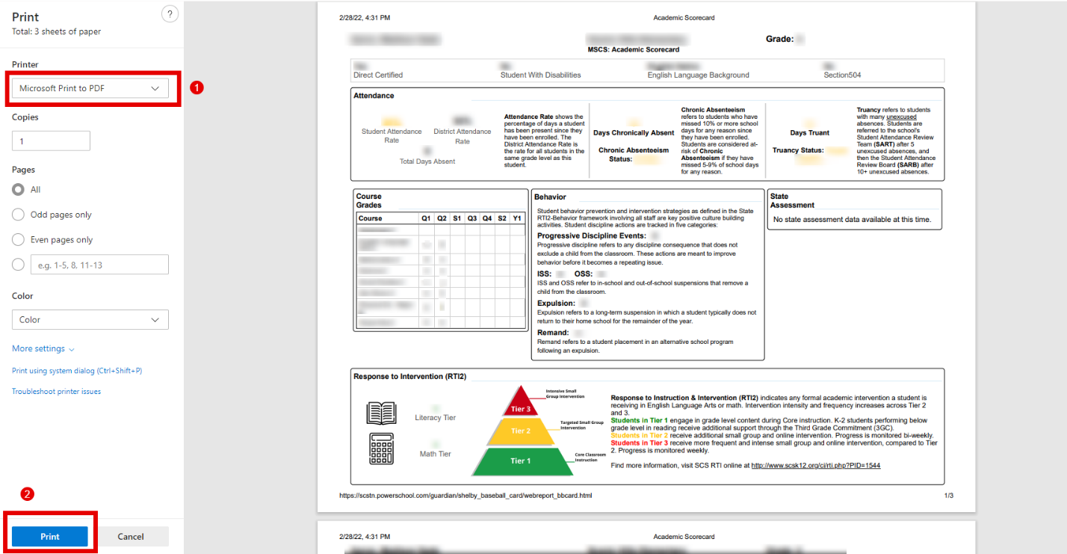
How to Print?
Once you click the blue ‘Print’ button at the top of the report, you will open a print menu. From here you can select the device you would like to print to (1) and then click Print (2).

Slide 16
Assessment Department Resources for Families

Slide 17
Testing Information
The following resources can be found on the Assessment page of the MSCS website (http://www.scsk12.org//assessment/):
The 2022-2023 Assessment Calendar
Assessment Rationale Document

Slide 18
Testing Information

Slide 19
TCAP Family Portal
The TCAP Family Portal is provided by the Tennessee Department of Education.
Parents can access the TCAP Family Portal at familyreport.tnedu.gov.
Parents can access their students’ test scores using the TCAP Family Portal.
One barrier to parents using the TCAP Family Portal is that it requires them to know their child’s TN student ID. This TN Student ID is different than the student’s PowerSchool ID. It is also important to put two zeros in front of the student’s 7-digit ID.

Slide 20
TCAP Family Portal

Slide 21
TCAP Family Portal

Slide 22
TCAP Family Portal

Slide 23
TCAP Family Portal

Slide 24
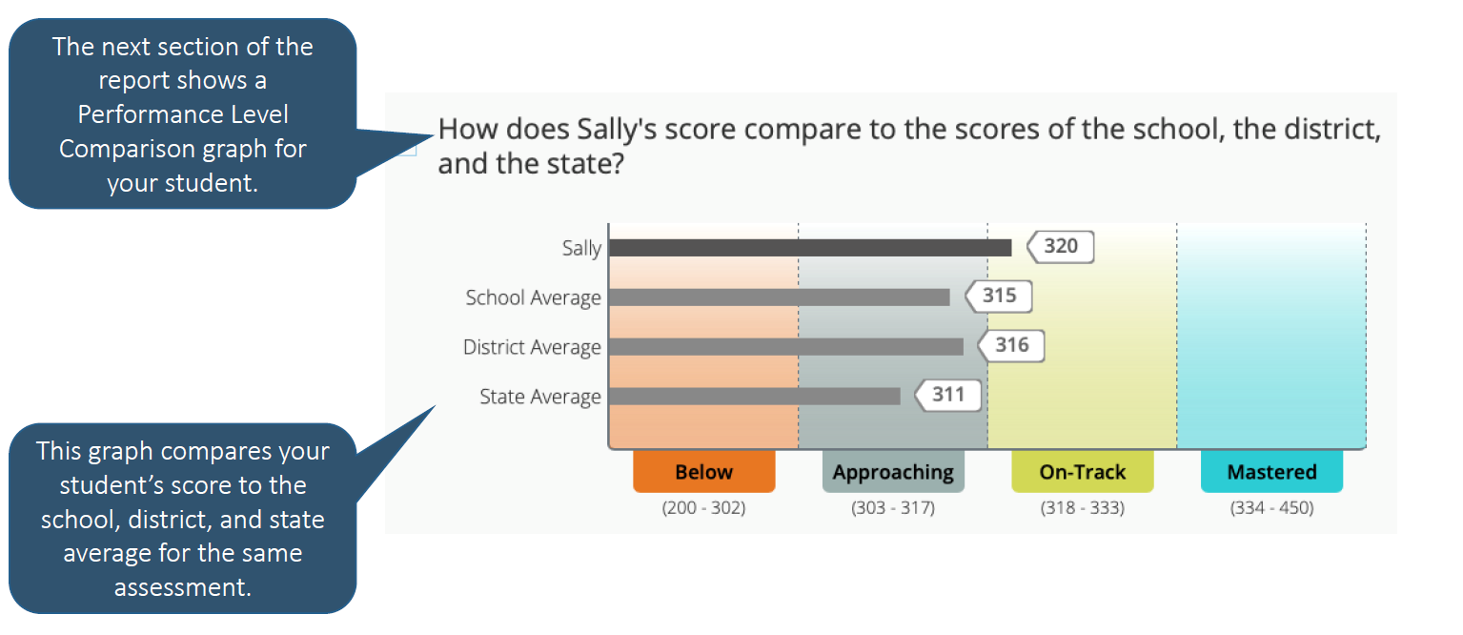
TCAP Family Portal

Slide 25
School’s Current Data and Academic Goals

Slide 26
Mastery Connect Data

Slide 27
MASTERY CONNECT
Grades K-12 will participate in standards-based assessments aligned with district ELA, math, and science curriculum maps.
Mastery Connect is an assessment platform that allows teachers to assess student mastery of specific standards.
Students can receive results instantly.
The results are displayed by standard, so although students will still get an overall percentage on any assessment taken, the focus is on the mastery of the specific standards.

Slide 28
Mastery Connect – District Formative Assessments

Slide 29
Mastery Connect – District Formative Assessments

Slide 30
Mastery Connect – District Formative Assessments

Slide 31
Universal Screener:
i-Ready

Slide 32
i-Ready
iReady is a computer-adaptive test (CAT).
Computer-adaptive tests continually adjust the difficulty of each test by determining each question based on the previous response.
The iReady assessment is used as a diagnostic screening tool to identify students who may need additional academic support and monitor student growth.
iReady is a K-8 intervention that provide specific tools and lessons to support areas the individual student is struggling.
In addition, iReady can help teachers determine appropriate instructional areas and skills to focus on during small group intervention instruction.

Slide 33
Universal Screener: i-Ready
Grades K-8 will participate in skill-based reading and math screener assessments.
i-Ready is the newly selected RTI² assessment platform for students in grades K-8 and will replace Illuminate/FastBridge in the 2022-2023 school year.
i-Ready can be used in both special education and regular education in order to meet the state guidelines related to effective implementation of RTI².
i-Ready provides in-depth information on students' strengths and areas of need for specific skills in reading and math.
The goal of the process is to monitor student progress as the student receives intervention with the expectation that the intervention will result in the student achieving at high levels of learning while closing the achievement gap among same-age peers.

Slide 34
i-Ready Data

Slide 35
I-Ready Data

Slide 36
MSCS Literacy Commitment

Slide 37
New! MSCS Literacy Commitment
On Tuesday, August 30, 2022, Shelby County School Board members approved the rules and regulations regarding policy #5013 with the additional guidelines for 3rd and 4th grade as outlined by the state. Therefore, current 2nd-grade students will not be held to any success criteria for retention purposes; however, academic support and intervention must continue for those students. Policy 5013 Promotion and Retention.
Memphis-Shelby County Schools identifies student achievement as its highest priority. The Literacy Commitment is a collaborative effort between schools, parents, and the community to ensure the success and reading readiness of our students.
There are two main components to the Literacy Commitment:
Primary Grades (K-2)
Upper Elementary (3-5)

Slide 38
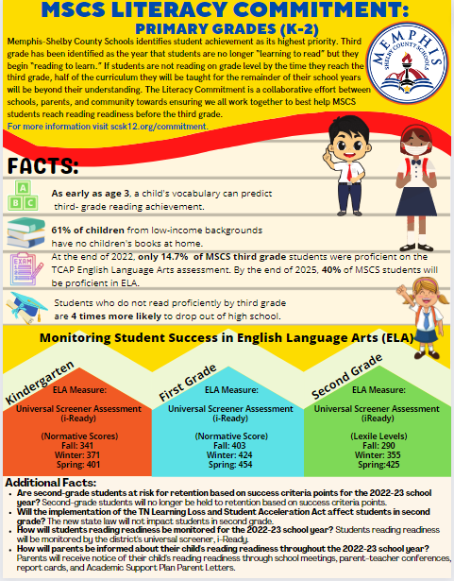
MSCS Literacy Commitment Primary Grade (K-2)
Students in Grades K-2
Focus: “Monitoring and Supporting Student Success”
For the 2022-2023 school year, students in grade 2 will not be required to meet success criteria points, nor will they be held to retention if they do not meet 8 out of the 12 success criteria points. This year, as a district, we will monitor and support student success in grades K-2 utilizing the universal screener, i-Ready.
Monitoring and Supporting: Any time a student is not meeting grade-level expectations, an academic support must be provided. An Academic Support Plan should be developed in EdPlan, parents should be notified, and the plans should be implemented until the student meets or exceeds identified ELA measure(s).
For more information visit scsk12.org/commitment.

Slide 39
Literacy Commitment 2022-2023
NEW Simplified Indicator
Monitoring & Supporting K-2nd Grade Student Success Identifying At-Risk Students (Not used for retention) | 1st Grade | Second Grade
Kindergarten ELA Measure | 1st Grade ELA Measure | Second Grade ELA Measure
Universal Screener Assessment – iReady Fall: 341 Winter: 371 *Spring: 401 | Universal Screener Assessment – iReady Fall: 403 Winter: 424 *Spring: 454 | Universal Screener Assessment – iReady Fall: 290 Winter: 355 *Spring: 425
* If student does not meet the required score/level, it is HIGHLY RECOMMENDED that the student attends Summer Learning Academy.

Slide 40
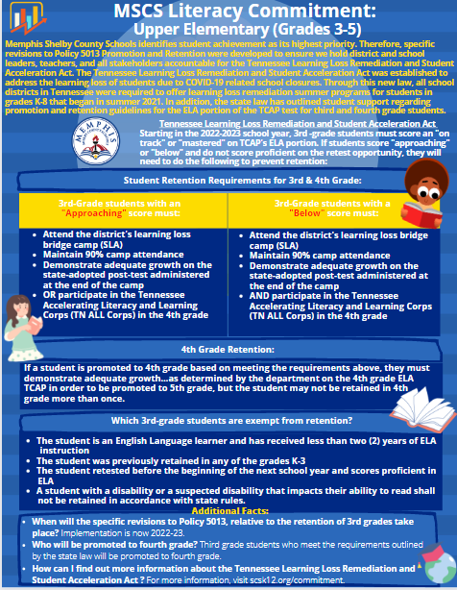
MSCS Literacy Commitment Upper Elementary (3-5)
Rising 3rd Grade Students
Focus: “Accelerating Student Learning”
“Beginning with the 2022-2023 school year, a student in the third grade shall not be promoted to the next grade level unless the student is determined to be proficient in English Language Arts (ELA) based on the student's achieving a performance level rating of "on track" or "mastered" on the ELA portion of the student's most recent Tennessee comprehensive assessment program (TCAP) test.”
For more information visit: scsk12.org/commitment.

Slide 41
MSCS Literacy Commitment
3rd Grade Retention

Slide 43
The MSCS Commitment to Our Students

Slide 44
The MSCS Commitment to Our Students
What parents can expect:
Personalized learning plans for each child
Frequent Communication about student progress via parent letters, Academic Scorecard, and report cards
Share distinct usernames and passwords for intervention that student can access at both home and school
Grade and content academic support events throughout the year
Access to parent resources via scsk12.org

Slide 45
School Communications Updates
School communications are sent home in yellow communication folders
Monthly calendars
Facebook, and Twitter
School website
Text messages
Phone calls
Emails
Pastries with Principal
Coffee with Counselor
MSCS District Website

Slide 46
MSCS Family and Community Engagement

Slide 47
Family and Community Engagement Ongoing Support
Homework Hotline: Certified Teachers tutor K-12 Tennessee students in all core subjects
Help is offered in seven languages: English, Arabic, Spanish, Hindi, Farsi, Mandarin, and Swahili.
Teachers are available Mondays-Thursdays, 4p.m.-8p.m. via phone (901)416-1234 and webchat http://homeworkhotline.info/
Family and Community Engagement Ongoing Support

Slide 48
The Commitment to our Parents

Slide 49
Family and Community Engagement Ongoing Support
Monthly Family Forums: provide an opportunity for all parents to gather, learn, and share important information to support student learning and success in school. Families can join the live virtual sessions on Microsoft Teams by visiting www.scsk12.org/familyforum.
Family and Community Engagement Ongoing Support

Slide 50
Before and After School Tutoring Program 22-23

Slide 51
About the Tutoring Progam
Structured tutoring programs have been proven to significantly increase student achievement when implemented in a clearly defined program that encompasses consistency, quality materials, and well-trained tutors. Our before/after school tutoring program is aligned as follows:
Dates: September 6, 2022-April 14, 2023
Students Impacted: 11,000
1:10 ratio maximum; 1:5 ratio minimum
3 hours per week & 2 Saturdays per month (optional)
Elementary students will receive additional instruction in ELA and/or Math
High school students will receive additional instruction in EOC content (9-10) and ACT prep (11-12)
Schools can decide whether a student participates in ELA or Math based on the student data
Students will not participate in both ELA/Math within the same semester
Students can potentially receive tutoring in one subject the first semester and a different subject the second semester

Slide 52
Turtoring Expectations
We ask that your child commits to our free tutoring program and guidelines by doing the following:
Be in attendance for every session
Be on time
Be prepared to learn
Be engaged in all lessons
Be attentive to the assigned tutor
Be respectful to classmates and assigned tutor

Slide 53
Important Information
Spaces are available on a first come, first serve basis
Students will need to be picked up promptly at (Add the time our tutoring ends)
After Tutoring Dismissal will occur (Add information specific to your school)
Students will need to be signed out from the After-School Tutoring Program
Before school tutoring drop off is located (Add information specific to your school)
Students will need to be signed in for the Before-School Tutoring Program
After-school tutoring snacks will be provided

Slide 54
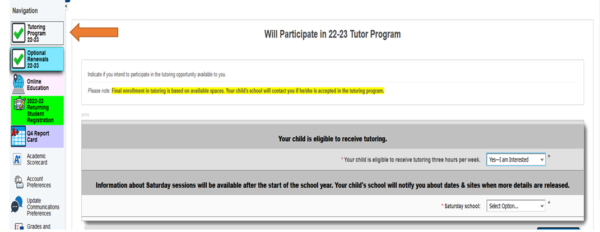
How to Register
Login to the PowerSchool Portal from a laptop or desktop
Select the green Tutoring Program Tab

Slide 55
How to Register
Answer both questions on the application
Submit Answers

Slide 56
Days & Times of Tutoring Program
Monday, Tuesday, and Thursday
3:30pm- 4:30pm

Slide 57
Contact Information
Regina Scott
901 416-4985
scottre@scsk12.org

Slide 58
S.E.E.D Registration/Enrollment, Withdrawals, & Transfers

Slide 59
S.E.E.D Registration/Enrollment, Withdrawals, & Transfers
Questions
Parents must complete Registration once a year by logging into their Parent Portal and completing the online application.
Registration for the 2023-24 school year will begin during the second semester. Parents are able to complete registration for the following year before this school year ends.
Parents that are unaware of their student’s assigned school for the next year can click here https://portal.schoolsitelocator.com/apps/ssl/?districtcode=70300
Entering Kindergarten students must turn 5 by August 15th to be able to register and enroll.
Each year 4-year-olds who will be turning 5 from August 16 - September 30 early entrance into Kindergarten. These children must be screened to determine if they will be eligible to enter into Kindergarten early.
School Choice opens in January.
School Choice Priority Period for applicants that apply opening week, will know their status by 2/17/2023.
School Choice re-opens 8/1/2023 – until the last Friday of the first week of school
School Choice has five specialty schools that have a wealth of opportunities for MSCS students: (Mt. Pisgah High, Bolton Agri-STEM, Medical College High, Middle College High, & Hollis F. Price)
If Parents need assistance, the ERA team will be available to assist at the Board Of Education during opening week of the School Choice application. Parents can also visit a Memphis Library to gain computer access.
School Choice transfer is based on space.
Withdrawal requests are now in the Parent Portal
Withdrawal requests are not the same as a transfer request

Slide 60
Discussion
Questions
???

Slide 61
Student Data Discussions, Parent-Teacher Conferences, & Next Steps

Slide 62
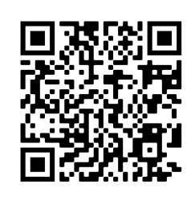
Parent Survey Link
English and Spanish: https://www.surveymonkey.com/r/Fall22FamilyDataNight

